Slide 1


A Place to Eat Food Access through Data
N1 HEALTH
Jason Wang

Slide 2


San Bernardino County
California
2,120,000
Low Food Access Individuals

Slide 3



San Bernardino County, California
33% of U.S. Vegetables
75% of U.S. Fruits and Nuts
Existing
Infrastructure
Policy Support
Funding Opportunities
2,120,000 Low Food Access Individuals

Slide 4
01
Populations and engagement estimations
AGENDA
02
Subgroup populations and benefits
03
Projected impact and future considerations

Slide 5

Population and Engagement Estimations
01
Population and Engagement Estimations
Subgroup Population and Benefits
Projected Impacts and Future Considerations

Slide 6
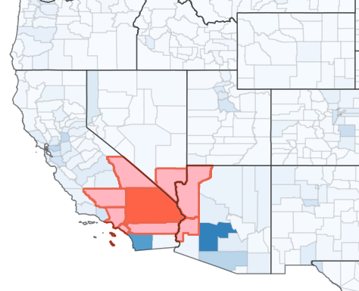

Population and Engagement Estimations
Clark
La Paz
Mohave
Inyo
Kern
Orange
Riverside
Los Angeles
2,120,000
Low Food Access Individuals
9 Counties
San Bernardino
Population and Engagement Estimations
Subgroup Population and Benefits
Projected Impacts and Future Considerations

Slide 7
Population and Engagement Estimations
Clark
La Paz
Mohave
Inyo
Kern
Orange
Riverside
Los Angeles
2,120,000
Low Food Access Individuals
80% In-County
Engagement Rate
30% Out-Of-County
Engagement Rate
San Bernardino
Population and Engagement Estimations
Subgroup Population and Benefits
Projected Impacts and Future Considerations

Slide 8
Population and Engagement Estimations
Clark
La Paz
Mohave
Inyo
Kern
Orange
Riverside
Los Angeles
2,120,000
Low Food Access Individuals
80% In-County
Engagement Rate
30% Out-Of-County
Engagement Rate
346,523 individuals
506,862 individuals
San Bernardino
Population and Engagement Estimations
Subgroup Population and Benefits
Projected Impacts and Future Considerations

Slide 9
Population and Engagement Estimations
Clark
La Paz
Mohave
Inyo
Kern
Orange
Riverside
Los Angeles
2,120,000
Low Food Access Individuals
853,385
Individuals Reached
40.20% Out-Of-County
Engagement Rate
San Bernardino
Population and Engagement Estimations
Subgroup Population and Benefits
Projected Impacts and Future Considerations

Slide 10
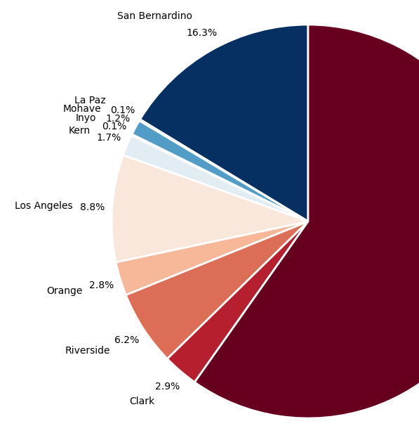
Population and Engagement Estimations
2,120,000
Low Food Access Individuals
40.20% Out-Of-County
Engagement Rate
San Bernardino
Population and Engagement Estimations
Subgroup Population and Benefits
Projected Impacts and Future Considerations

Slide 11

Subgroup Population and Benefits
02
Population and Engagement Estimations
Subgroup Population and Benefits
Projected Impacts and Future Considerations

Slide 12
Subgroup Population and Benefits
Individuals who are….
Whites
Hispanics
Low Income
548,999
301,997
281,785
Multiracial
Seniors
Children
222,800
168,158
102,148
*Self-identified
Population and Engagement Estimations
Subgroup Population and Benefits
Projected Impacts and Future Considerations

Slide 13

Subgroup Population and Benefits
Ethnic groups that are expected to benefit the greatest
Whites
Hispanics
Asians
548,999
301,997
169,173
*Self-identified
Population and Engagement Estimations
Subgroup Population and Benefits
Projected Impacts and Future Considerations

Slide 14



Projected Impact and Future Considerations
Population and Engagement Estimations
Subgroup Population and Benefits
Projected Impacts and Future Considerations

Slide 15
Decrease Low Access Food Rates
Benefit the young – and the old
Improve Connections
Projected Impact and Future Considerations
Reduce rates by an estimated 80% within San Bernardino County and 30% within surrounding counties. Estimated 40.2% of county populations.
Support low-income households, children, senior citizens,.
Estimated greater than 330,000 individuals
California, as a major operating hub for agricultural goods makes it a great strategic location to build farm to program connections, leverage existing infrastructure, or secure policy support.
Population and Engagement Estimations
Subgroup Population and Benefits
Projected Impacts and Future Considerations

Slide 16
Decrease Low Access Food Rates
Benefit the young – and the old
Improve Connections
Projected Impact and Future Considerations
Reduce rates by an estimated 80% within San Bernardino County and 30% within surrounding counties. Estimated 40.2% of county populations.
Support low-income households, children, senior citizens,.
Estimated greater than 330,000 individuals
California, as a major operating hub for agricultural goods makes it a great strategic location to build farm to program connections, leverage existing infrastructure, or secure policy support.
Population and Engagement Estimations
Subgroup Population and Benefits
Projected Impacts and Future Considerations

Slide 17



Assess Climate Change and Human patterns
Digital Divides and Technology Access
Continuous Data Collection
Projected Impact and Future Considerations
California has unique vulnerabilities due to its climate and environment. Analyzing historical drought patterns and future climate projections can help plan appropriately. California’s also lends itself to a different economy and seasonal patterns, analyzing it closely is important for understanding timelines.
Many food access programs rely on digital tools. Nearly 45% of the population in the counties are from a minority background. Evaluating English fluency and digital literacy may improve engagement rates and help future planning.
Analysis is only as good as the data. Further data collection is always a necessity but never a replacement for human interaction and understanding that the ground crew has. Ensure there is a pipeline for input and feedback.
Population and Engagement Estimations
Subgroup Population and Benefits
Projected Impacts and Future Considerations

Slide 18
Thank
You!

Slide 19
Disclaimer
The findings and insights presented in this analysis are based on the available data and should be interpreted with caution. Correlation does not imply causation, and the results may be influenced by confounding variables or limitations inherent in the dataset. This analysis is intended for informational purposes only and does not constitute definitive conclusions or actionable recommendations without further validation.

